Slide 1
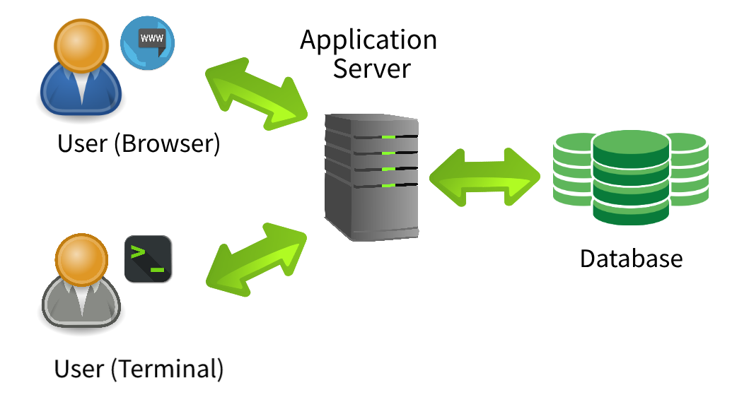
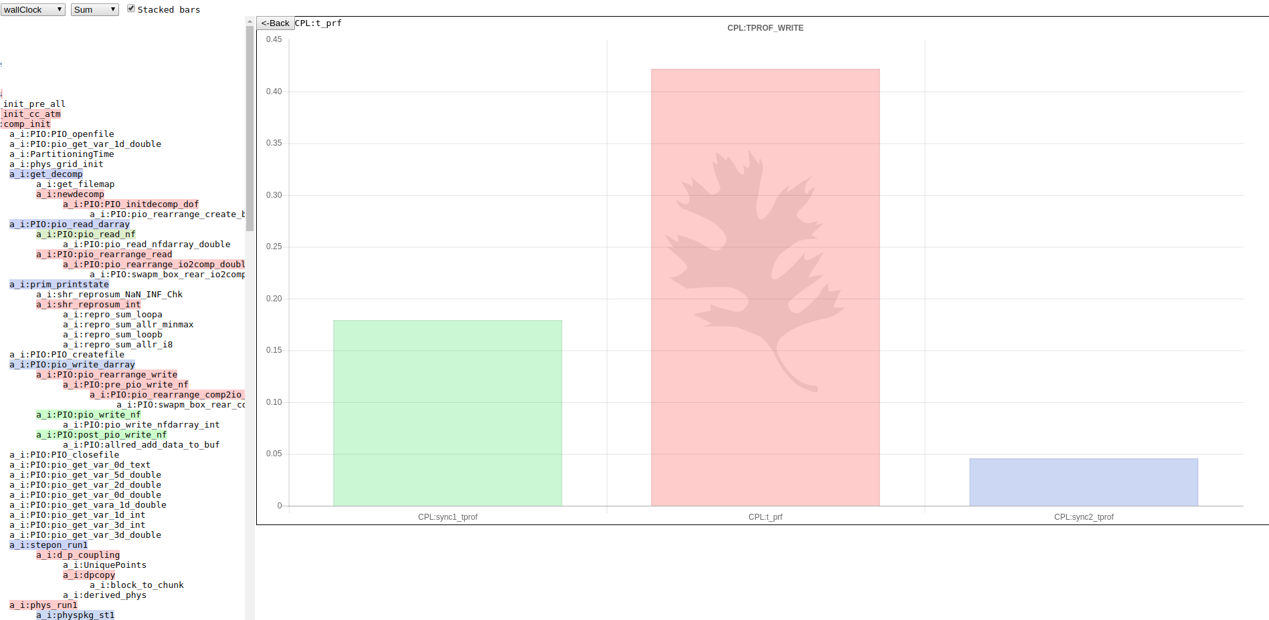



Performance Analytics for Climate Experiments
Gaurab KC^{a,b}, Zachary Mitchell^{a,c} and Sarat Sreepathiª
a. Computer Science and Mathematics Division, Oak Ridge National Laboratory, Oak Ridge, Tennessee, USA
b. University of Tennessee, Knoxville, Tennessee
c. Pellissippi State Community College, Knoxville, Tennessee
The Energy Exascale Earth System Model (E3SM) is a development and simulation project to investigate energy-relevant science using code optimized for DOE’s advanced computers.
Performance Analytics for Climate Experiments
(PACE) is a collection of tools to summarize
performance data collected from E3SM
experiments to provide insights and make them
available through web portal.
Able to process experiment into structured output and store in database.
Capable to summarize the performance of E3SM experiments visually.
Introduction
.
Work Flow
Conclusions
Future Work
Refine database schema and mapping for multiple experiment types and outputs.
Implement better algorithms to increase speed and security of web portal.
Increase storage capacity to allow user to work with large E3SM experiments results.
Test and optimize for concurrent users.
Enhance web portal design.
Results
Back-End:
Developed a workflow:
      Aggregate E3SM experiment files.
      Upload aggregated files to server.
      On server, we process experiment files into structured format.
      Store structured output in database.
Front-End:
    Retrieves data from database.
    Displays data plot images in browser.
.
Performance of E3SM experiment by PACE:
Figure 1: Wall-Clock time for each processes
Methods
Acknowledgments:
This work is supported by U.S. Department of Energy, Office of Science, Office of Workforce Development for teachers and Scientist (WDIS) under the Science Undergraduate Laboratory Internship Program.
References:
E3SM Project, DOE. Energy Exascale Earth System Model v1. Computer Software. 23 July. 2018. Web. https://doi.org/10.11578/E3sm/dc.20180418.36
Mentor’s Contact Information:
Sarat Sreepathi
Email: sarat@ornl.gov
Author's Contact Information:
Gaurab KC
Email: gkc@vols.utk.edu

